Slide 1

CRAFTING AND COMPELLING WEBSITE ANALYSIS, AUDIT AND RECOMMENDATIONS
Business presentation

Slide 2
ABOUT WIPRO
Wipro Limited is an Indian multinational technology company that provides IT services, consulting, and business process services. It's one of the leading Big Tech companies in India.

Slide 3

PRODUCTS AND SERVICES
Wipro offers a wide range of products and services, including consumer care products, IT services, infrastructure engineering, and smart manufacturing solutions
Consumer care products
Wipro Consumer Care and Lighting: A fast-growing FMCG company that sells personal care and skin care products
Hygienix: An alcohol-based hand sanitizer that kills germs

Slide 4
SERVICES
IT services
Cloud computing
Wipro’s Cloud Managed Services focuses on managing hybrid and public cloud environments. It enables customers to consume services from public cloud involving IaaS and PaaS services alongside the cloud native services, DevOps, micro services, containers, and data protection. Wipro’s Cloud Managed Services provide cloud experts that deliver 24×7 ongoing management of cloud services. This includes track and report on cost and consumption, optimization recommendations, performance and availability monitoring and automation. All of these are enabled with streamlined and automated processes and workflows for faster delivery and reduced costs.
Computer security
Wipro CyberTransform is integrated risk and security platform that delivers strategy-first cybersecurity advisory and implementation services. CyberShield is wipro's industry-leading suite of managed services that defend business operations with on-demand cyber resilience management.

Slide 5
Artificial intelligence
Wipro's artificial intelligence focus revolves around their proprietary platform called "Wipro HOLMES," which is a comprehensive AI and automation solution used to help businesses transform by leveraging machine learning and data analytics to optimize operations, improve customer experiences, and drive innovation across various business functions; essentially positioning Wipro as a leader in providing AI consulting and implementation services to clients across industries.

Slide 6
Robotics
Wipro offers robotics and automation solutions for industrial and commercial applications. These include autonomous vehicles, robotic process automation, and industrial automation

Slide 7

Website platform
The Wipro website is likely running on a combination of cloud platforms, primarily leveraging Microsoft Azure and Google Cloud Platform (GCP), as Wipro heavily promotes its expertise in both cloud services and actively partners with them to deliver solutions to clients; this allows them to scale their website effectively and provide a robust online presence.

Slide 8
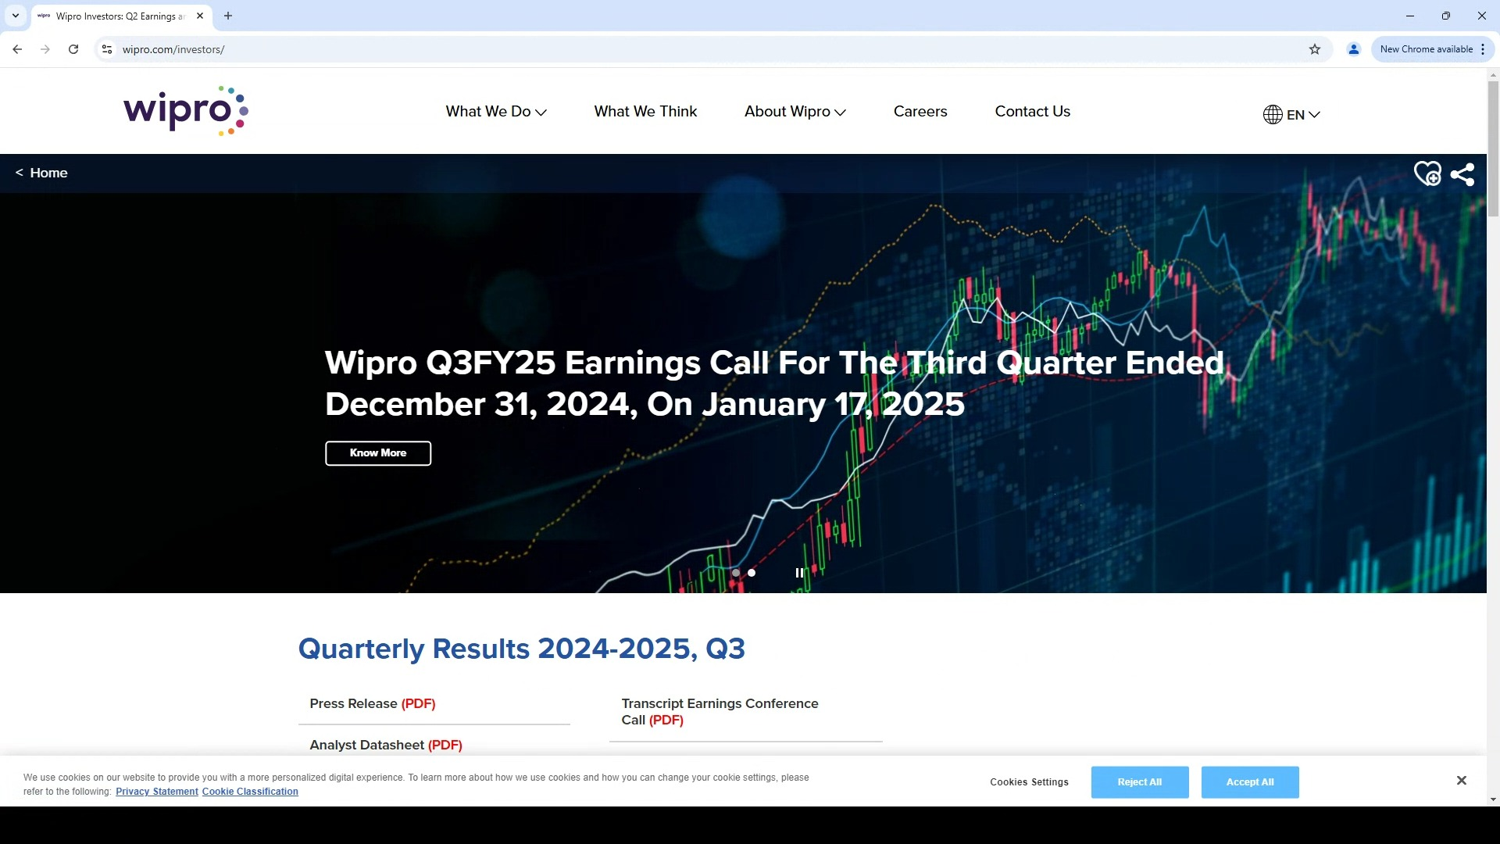
Responsive design test
Currently gearing up for a ground-breaking launch
Our new offerings will captivate the market
Our marketing campaign will generate anticipation
Product launch timeline

Slide 9
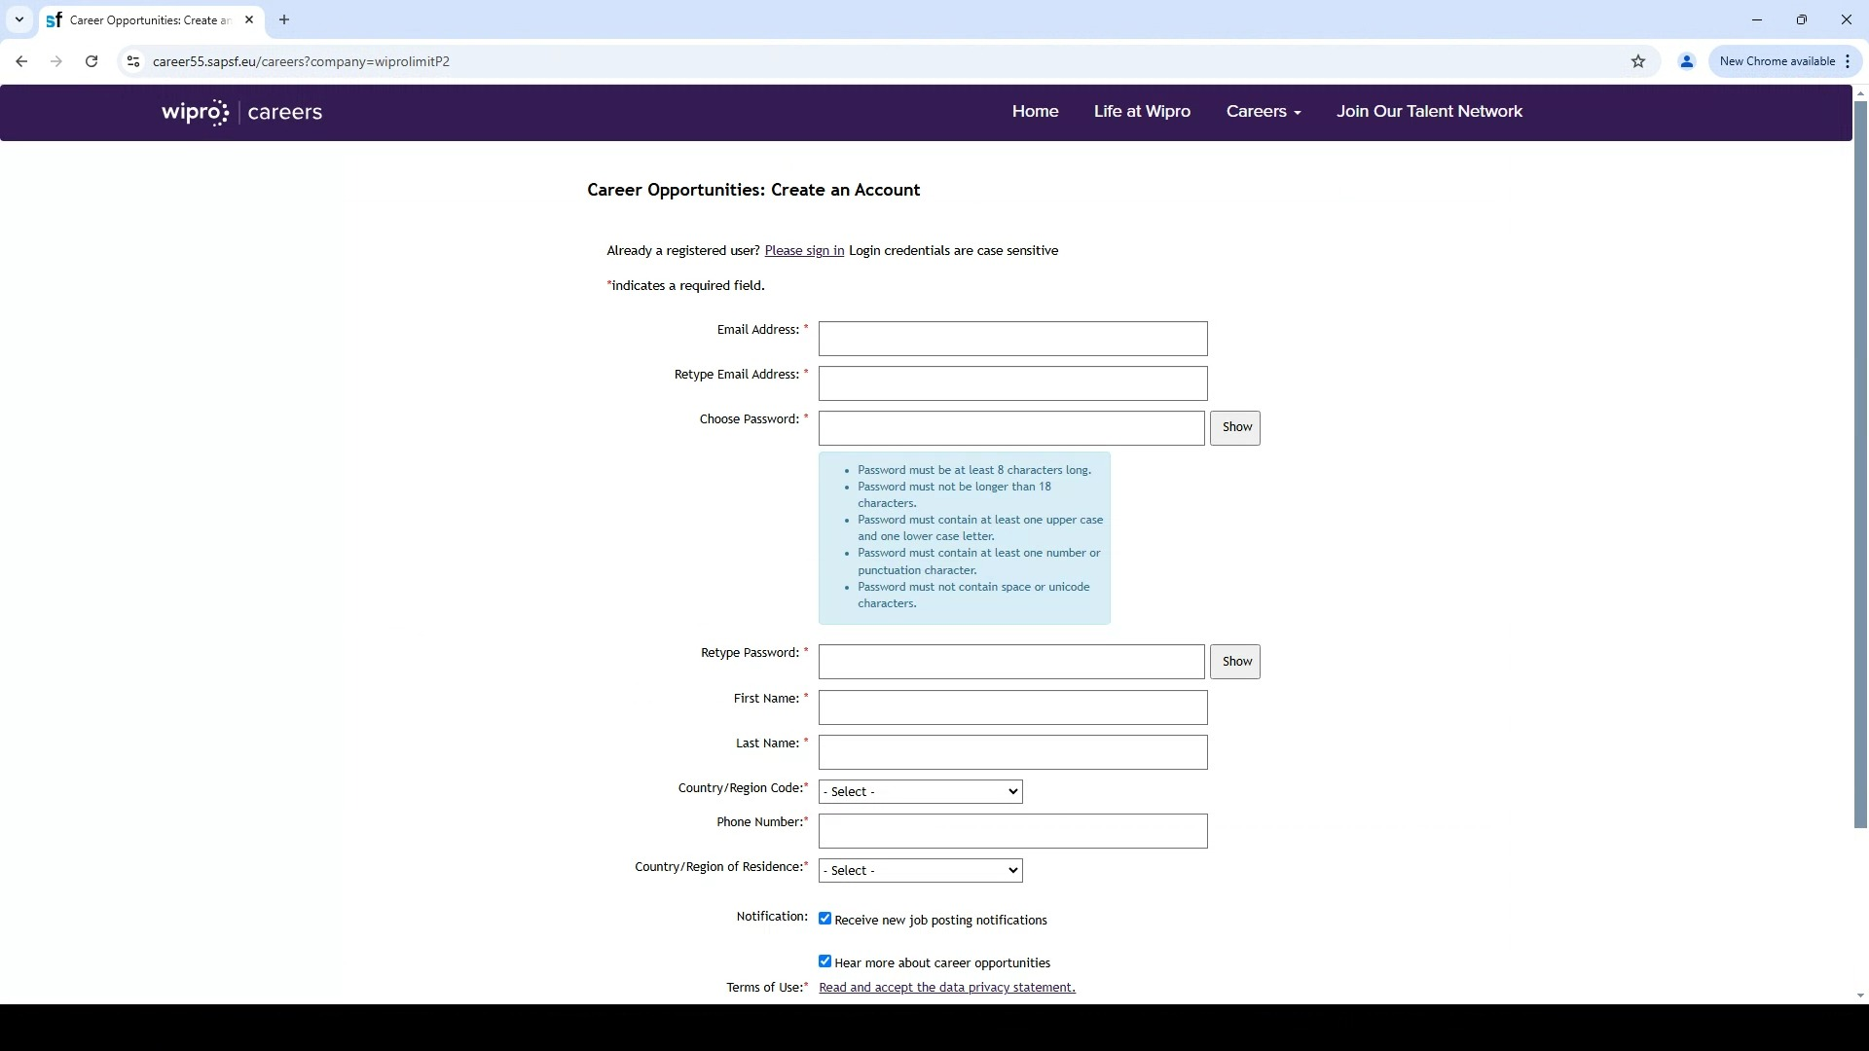
Responsive design test

Slide 10
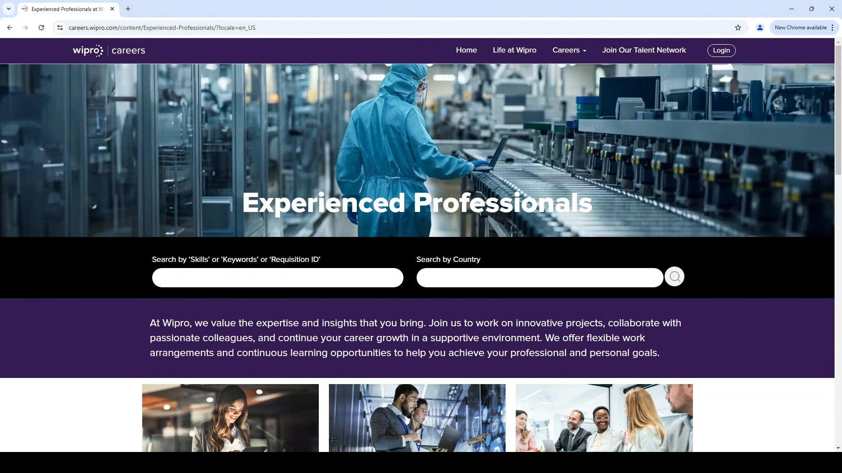
Responsive design test

Slide 11
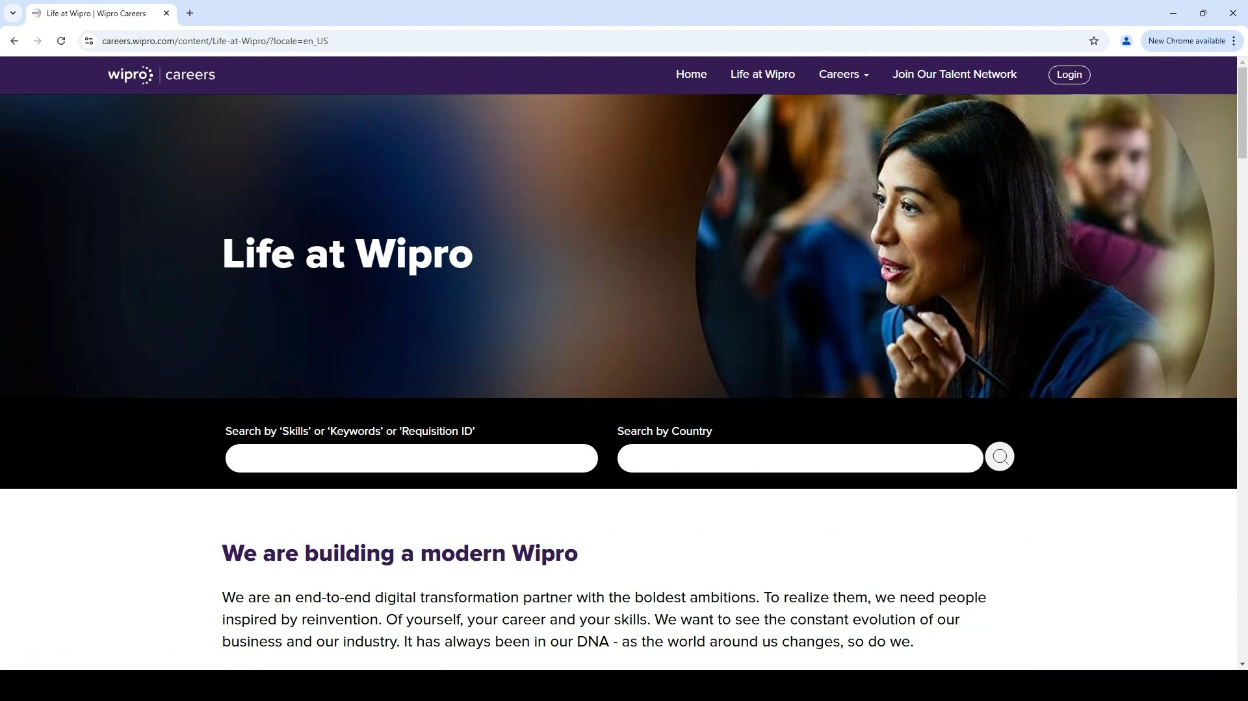
Responsive design testing

Slide 12
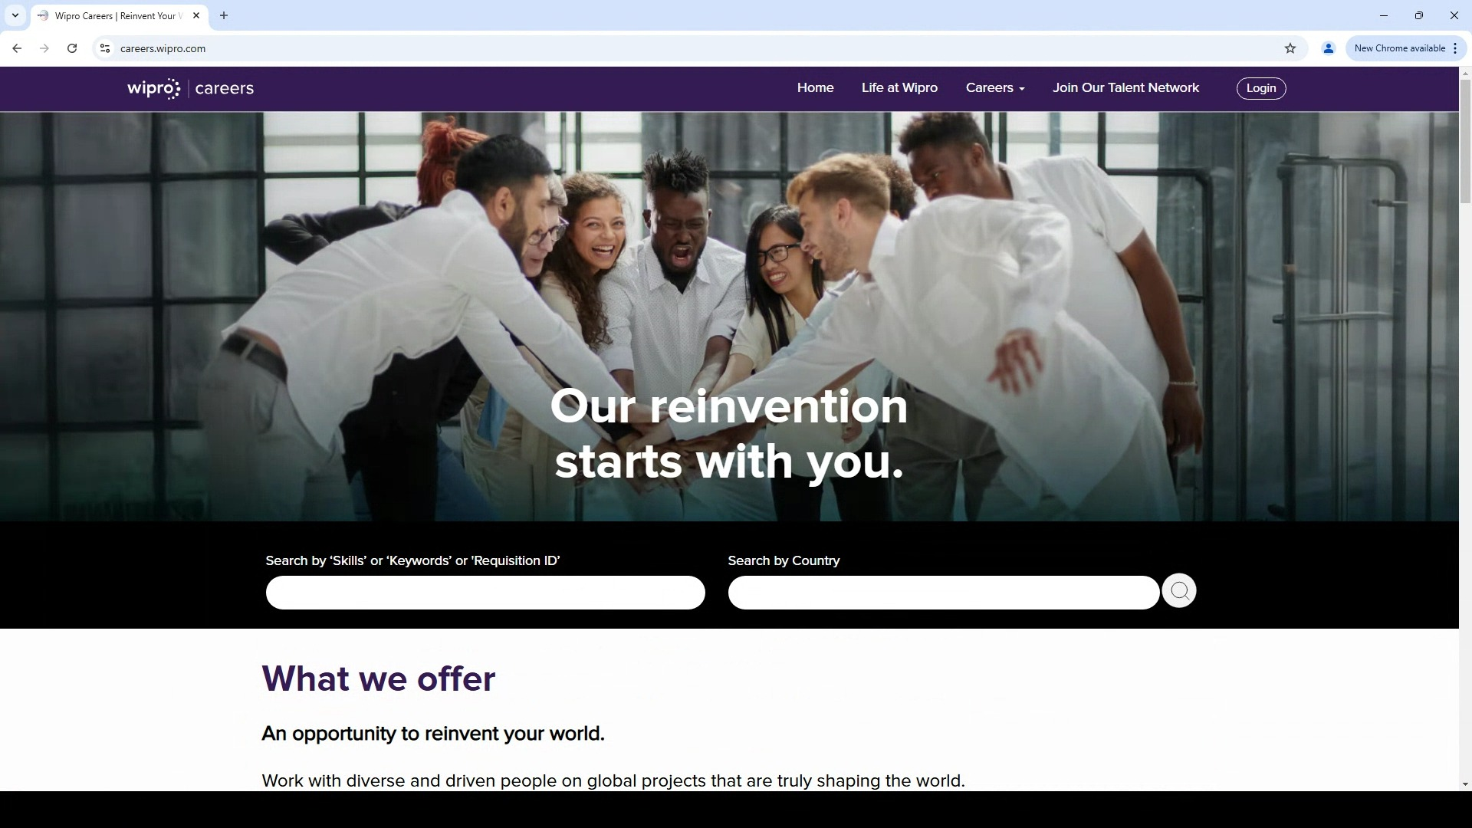
Responsive design test

Slide 13
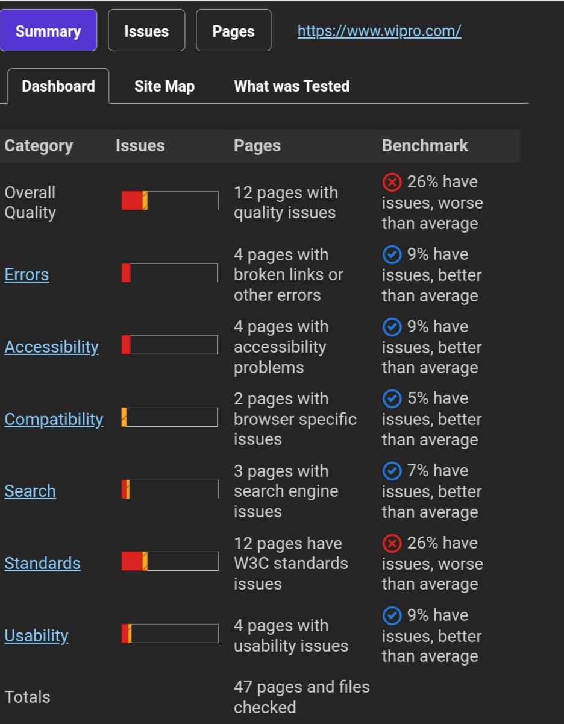
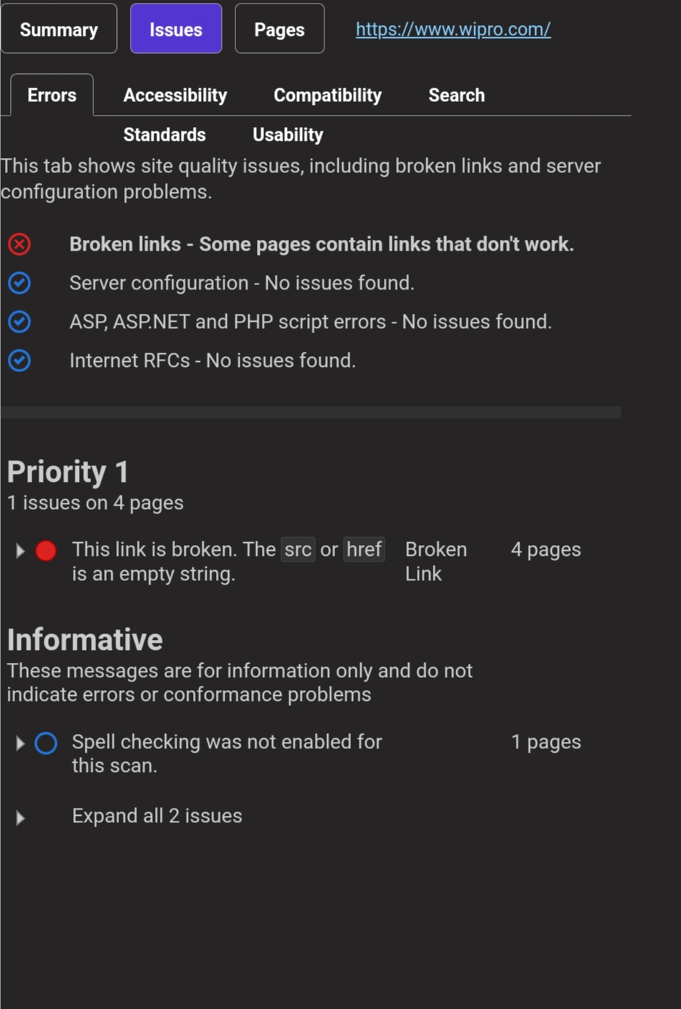
Website mistake identification

Slide 14
Best practices list:
Utilize Responsive Design
Responsive design ensures that a website adapts to different screen sizes and devices, providing a seamless user experience across all platforms, including desktops, laptops, tablets, and mobile phones.
With more people accessing websites on mobile devices nowadays, responsive design is more important than ever. The lack of it may cause your website to not display correctly on certain devices. This results in a poor user experience, which can lead to high bounce rates and low engagement on your site.

Slide 15
Use whitespace effectively
Whitespace, or also known as negative space, is the empty space between text, images, and other design elements on a website. Using whitespace effectively can greatly improve the readability and usability of a website. It can help create a visual hierarchy, making important elements stand out and less important ones recede into the background.
It also helps the users scan content more efficiently and gives the website a more aesthetically pleasing design, creating a sense of elegance and sophistication.

Slide 16
Choose colors carefully
Choosing the right colors is a critical aspect of web design. The color combinations you select can literally make or break your design. The reason why colors matter so much is that they can evoke different emotions and create different atmospheres. They can also help draw attention to specific parts of a design or create balance and harmony.
Use high-quality images and videos
Visual content, including images and videos, plays a crucial role in engaging users and conveying information on a website. High-quality content captures visitors’ attention, conveys professionalism, and enhances the user experience by breaking up text and providing visual interest

Slide 17
Simplicity is key when it comes to designing website navigation. A simple and clear navigation system ensures that visitors can easily find the information they need, resulting in a positive user experience.
To achieve this do the following:
Limit the number of menu items to a minimum and use descriptive labels to help visitors understand what they will find when they click on them.
Consistency throughout the website is also crucial, put the menu items in the same order and location on each page.
A search bar is also essential to make it easy for visitors to search for specific content or products on the website, be sure to include it.
Don’t insert too many links, they will distract your reader from the main content.

Slide 18
Design for everyone (Accessibility)
In today's digital world, ensuring your website is accessible to everyone is no longer optional. Web Accessibility Initiative (WCAG) guidelines provide a framework for creating websites that are usable by people with disabilities. By following these guidelines, you can create a more inclusive website that reaches a wider audience and improves the user experience for everyone.
Here are some key accessibility features to consider:
Alt Text: Descriptive alternative text for images allows screen readers to convey the image's content to visually impaired users.
Keyboard Navigation: Ensure all website functions can be accessed and navigated using just a keyboard, catering to users who may not be able to use a mouse.
Color Contrast: Maintain sufficient color contrast between text and background for better readability, especially important for users with visual impairments.

Slide 19
Conclusion
Designing a beautiful and user-friendly website is not just about the technical aspects and features. It’s also about creating an enjoyable and memorable experience for your visitors. By taking the time to understand your audience’s needs and preferences, you can design a website that resonates with them and keeps them coming back.
Utilizing responsive web design tools, effective use of whitespace, consistent typography, careful color selection, and other tips we mentioned, are all important factors in creating a successful website. By doing so, you’ll not only create a beautiful website but also one that connects with your audience and makes a positive impact on their lives.
Lastly, staying informed about the latest web design trends in 2024 and creating a web design style guide to provide consistency during the design process will take your website to the next level.

Slide 20
